Slide 1


A-T-L-A-S Atlas!
By:
Atharv Bhatt

Slide 2
Tasks Completed
Task 1 + extra work
Task 2 + extra work
Bonus Task
Paper Reading
01
02
03
04

Slide 3
Objectives
Main Goal:
To derive strategic insights from the Atlas game using graph theory.
Specific Objectives:
Model the game as a directed graph where an edge exists if the last letter of one place equals the first letter of the next.
Compute key network metrics (degree centrality, betweenness, trap score, etc.) to identify strategic nodes.
Simulate game strategies to compare random and letter‑based approaches.
Detect communities within the network to see if natural groupings exist that might inform gameplay.
Extra Efforts:
I developed 2D and 3D visualizations, an interactive PyVis network, and a Streamlit dashboard to explore the network.
I also designed creative experiments like survival path simulation and semantic clustering to deepen my analysis.

Slide 4
Data Sources & Graph Construction
Data Sources:
Countries: 249 unique country names from ISO 3166‑1 (DataHub Country List).
Cities: Approximately 500 most populated (unique) city names from (World Population Review).
Graph Construction (Atlas Rule):
I created a directed graph using NetworkX where an edge is drawn from node A to node B if the last letter of A equals the first letter of B.
I built separate graphs for countries, cities, and a combined graph.
Visual Aid:
I designed a schematic diagram showing how nodes and edges are formed based on the Atlas rule.

Slide 5
Metrics and Methodology
Metrics Computed:
Degree Centrality: Identifies hubs (e.g., Afghanistan, Azerbaijan).
Betweenness Centrality: Highlights nodes that serve as bridges.
Trap Score (Custom): Measures how “trapping” a node is by evaluating the options available from its neighbors.
Graph Density & Clustering Coefficient: Evaluate overall connectivity and local clustering.
Survival Path Length: Estimated via Monte Carlo simulation to gauge the “safety” of moves.
Methodology Overview:
I used NetworkX for graph creation and applied these metrics to understand which nodes are most strategic.
I then simulated game strategies (random vs. letter‑gap) to test my hypotheses.
Extra Insight:
My custom trap score and survival simulations helped me identify nodes that not only have high connectivity but also restrict the opponent's options, which i used as my strategy in the simulation to get a win rate >90%.

Slide 6
Visualizations – 2D and 3D Layouts
Note: I have implemented all the 3 types of visualisations for all three datasets (countries, cities, combined)
2D Visualizations:
I used the Kamada‑Kawai layout to produce clear, labeled 2D graphs of the country, city, and combined networks.
These plots reveal connectivity patterns and highlight strategic hubs.
3D Visualizations:
I implemented a 3D animated Plotly visualization that shows a globe‑like network.
This dynamic view helps me see spatial clusters and connectivity that aren’t obvious in 2D.
PyVis Visualization:
I created an interactive PyVis network that opens in a browser.
Advantage: Users can zoom, drag, and hover over nodes to see details—enhancing my analysis.

Slide 7
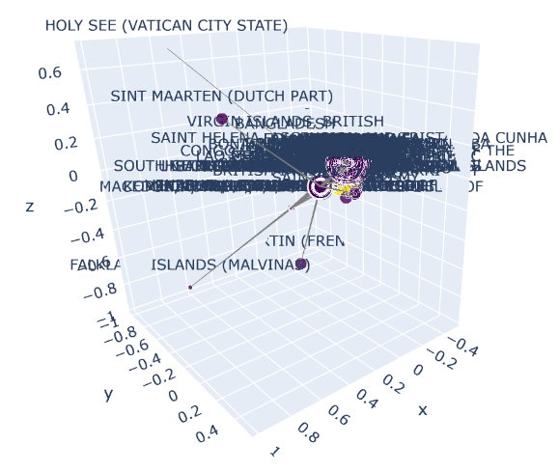
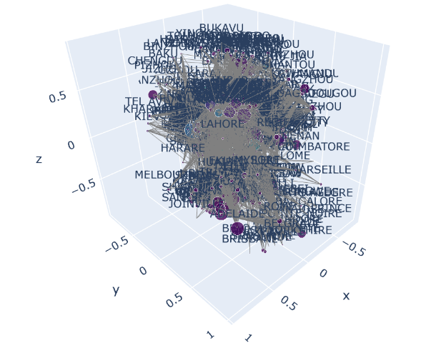
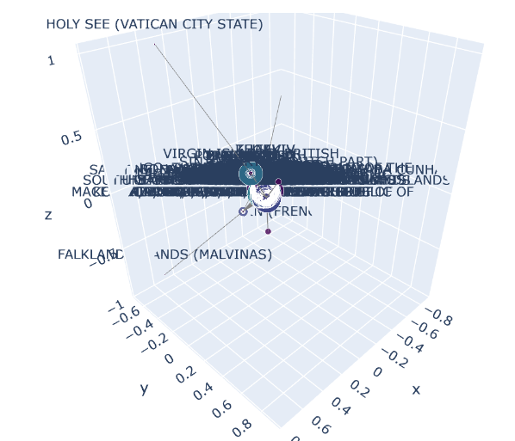
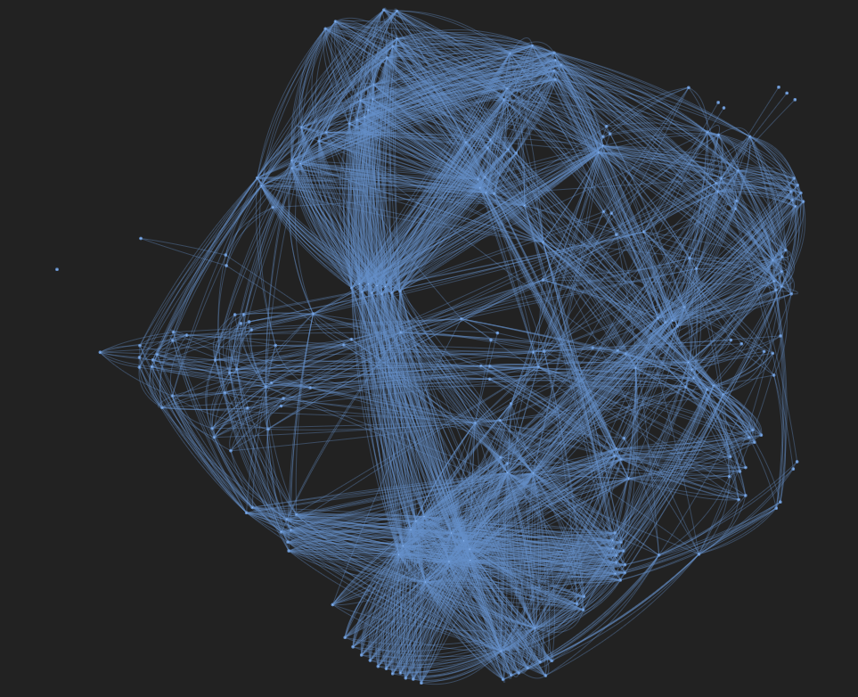
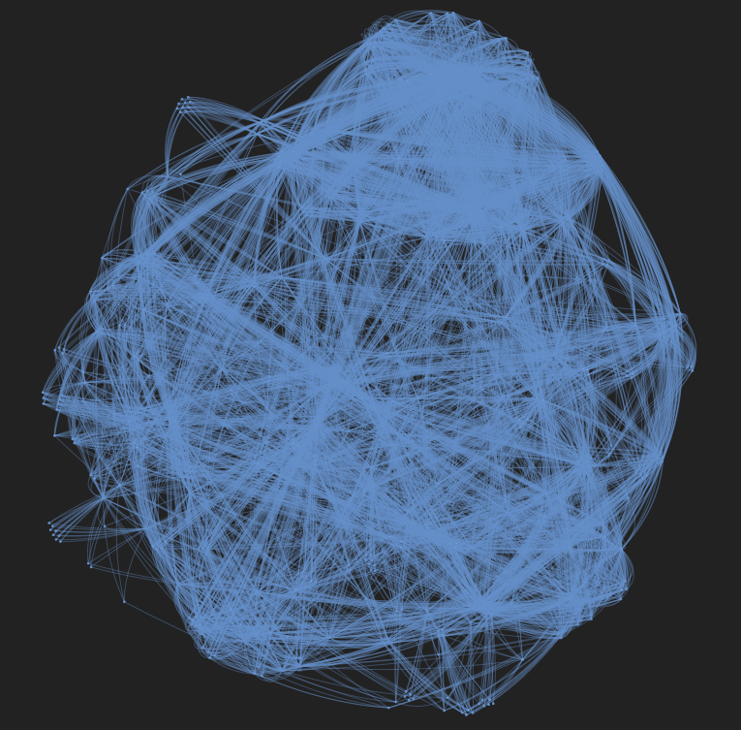
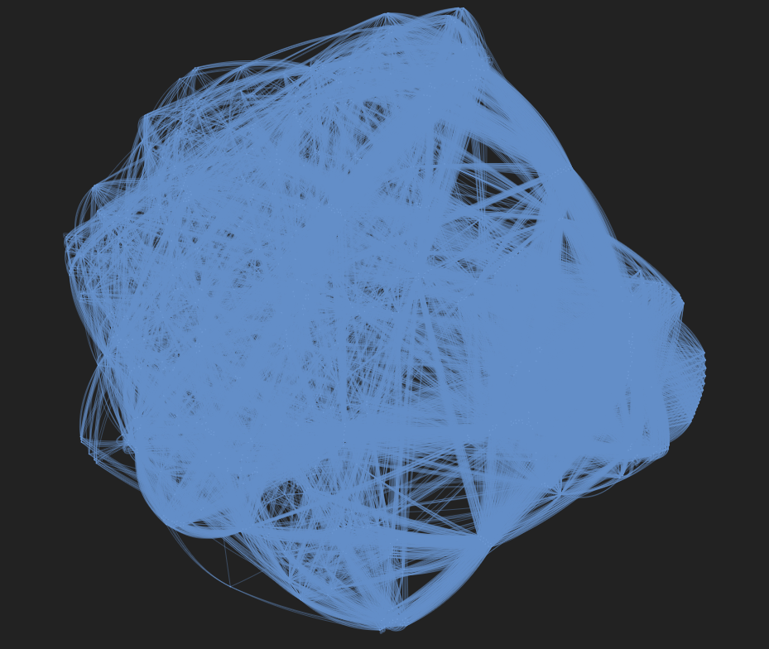

Slide 8
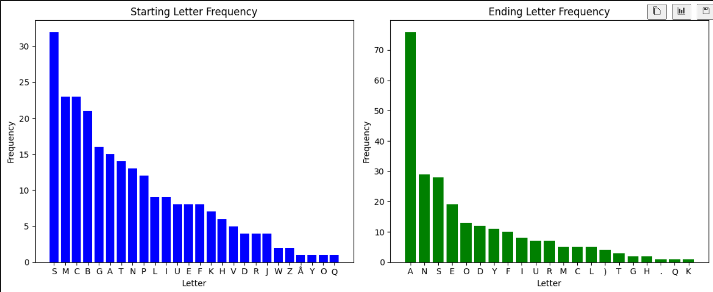
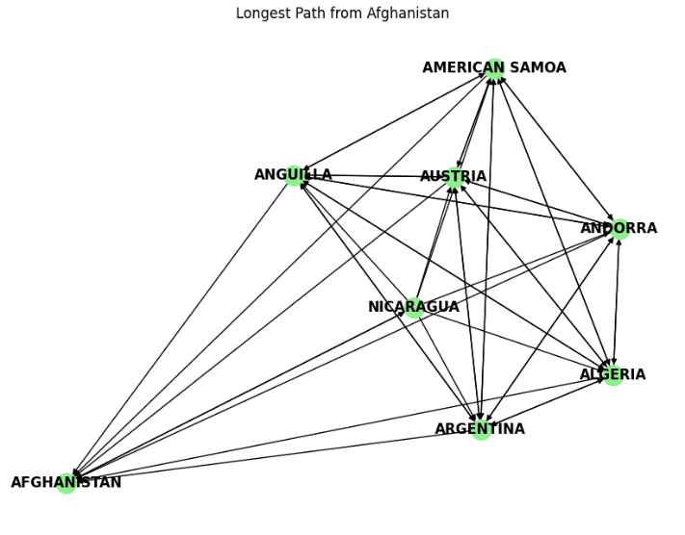
Extra Work
Calculated the Starting and Ending Letter Frequency of the countries dataset to implement in my “Letter Gap Strategy” algorithm (explained in page 11)
I was curious about it so I Implemented Survival Path Length via Monte Carlo Simulation: Estimated via Monte Carlo simulation to gauge the “safety” of moves.
Observations: The simulations yield an average survival path length of about 19 moves for top strategic nodes. This metric serves as a proxy for the “safety” of a move, though it may be sensitive to simulation parameters.
I also computed High Out-Degree Nodes, Bottleneck Nodes, and PageRank Influencers for all three datasets (countries, cities, and combined).

Slide 9
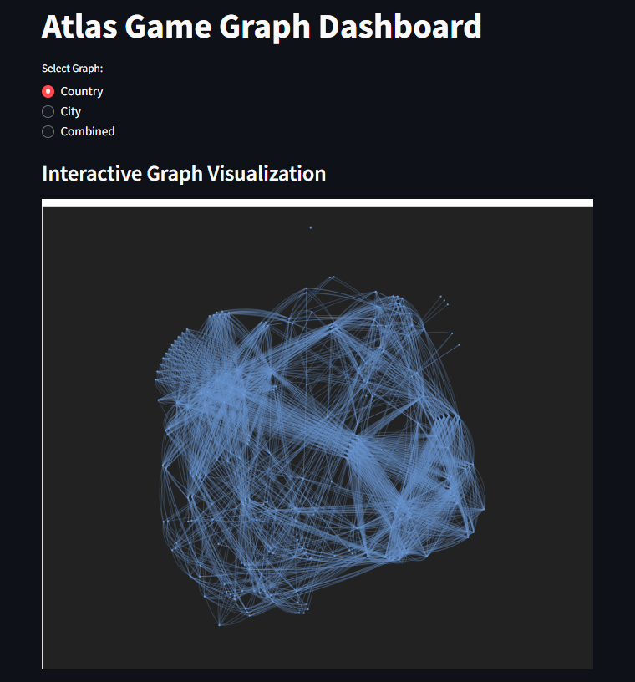
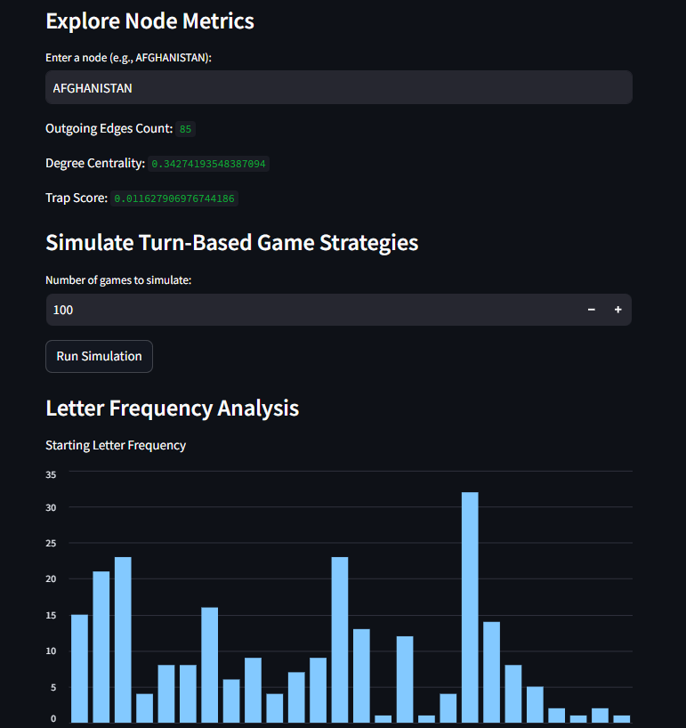
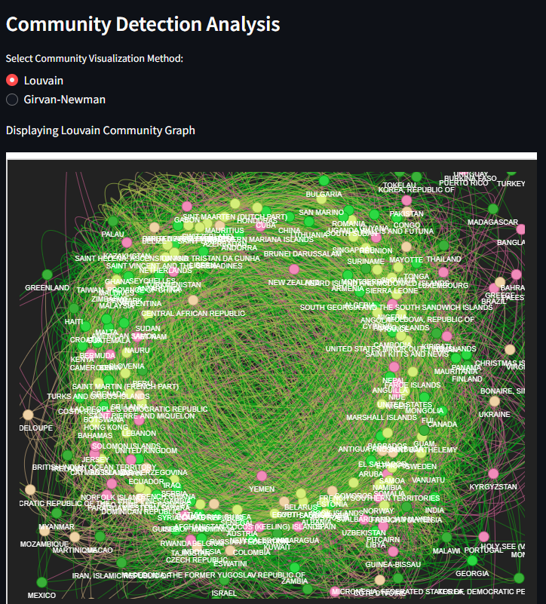
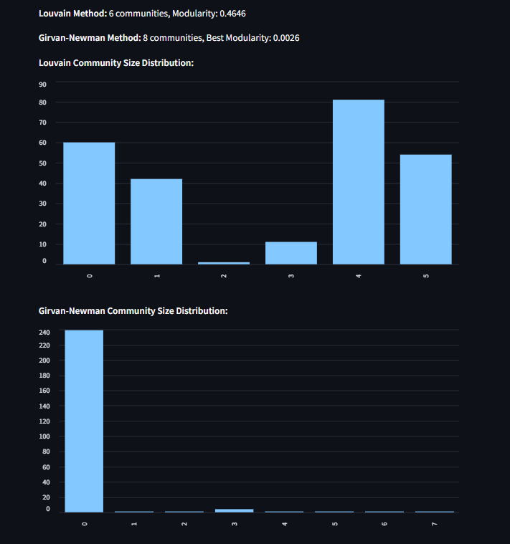
Interactive Dashboard
Dashboard Features:
Developed with Streamlit, the dashboard allows me to select different graphs (Country, City, Combined).
I can view node metrics by entering a node name (e.g., Afghanistan) to see degree centrality, outgoing edges, and trap score.
The dashboard includes simulation options to compare game strategies and visualize community detection.
My Experience:
I integrated interactive elements to let users explore metrics and even see community graphs colored by detection method (Louvain vs. Girvan–Newman).

Slide 10
Simulation of Game Strategies
Strategy Experiments for turn based ATLAS:
I first developed a strategy where the player starts at the node with highest degree centrality and always picks the node with the highest out-degree (most outgoing edges) assuming that having many outgoing moves is beneficial and to exhaust all valid moves. But this strategy did not work at all since the random algorithm had the most amount of possible choices at every move, so it would eventually select a move that would be a trap node, and our algorithm has not accounted for that. Result: Strategic win rate: 10.0% vs Random win rate: 90.0%.
Next, i improved on the previous strategy by trying to simulate multiple different strategies to see which one is the best. Min-Out Strategy: Selects the neighbor with the lowest out-degree (i.e., minimizes opponent options). Composite Strategy: Considers trap scores alongside out-degree. Lookahead Strategy: Looks one move ahead to minimize the opponent’s best move.
Reason for failure: The Min-Out Strategy tries to minimize opponent options, but it can still trap itself too soon. The Composite Strategy uses trap scores but weighs them incorrectly, which leads to suboptimal choices. The Lookahead Strategy performs better than the others by considering opponent moves, but it only looks one move ahead, so it misses deeper traps. Result: Min_out Strategy win rate: 4.0%
Composite Strategy win rate: 7.0%
Lookahead Strategy win rate: 25.0%
Random Strategy win rate: 35.0%

Slide 11
Simulation of Game Strategies
Finally, my winning logic was: Compute the metrics regarding places with the least amount of starting letter (for example: 5 countries in the dataset start with the letter 'x') and then check if the amount of countries whose ending letter is 'x' is more than the amount of countries whose starting letter is 'x'. Prefer nodes ending with rare letters (e.g., "X"). Implement a strategy that does this for all letters and uses that information to win the game.
Therefore, I implemented the “Letter Gap Strategy”: A) Minimizing Opponent Options: Selected moves that lead to nodes with the fewest outgoing edges (i.e., minimal opponent moves). B) Incorporate the Trap Score: I combined out-degree with your custom trap score to choose moves that are likely to “trap” the opponent. C) Game-Theoretic Approach: Used a minimax or look-ahead strategy to simulate a few moves ahead.
RESULTS: Turn-based simulation over 100 games: Random Strategy wins: 4 (4.0%) Letter Gap Strategy wins: 96 (96.0%)

Slide 12
Strategic Insights from Graph Metrics
Key Observations:
Nodes like Afghanistan, Azerbaijan, and Argentina constantly appear as strategic hubs across multiple metrics.
Why?
High degree centrality indicates many connections.
High betweenness shows these nodes serve as bridges.
A high trap score suggests that while they are well connected, their successors have limited moves.
What does this mean for the Gameplay:
Starting in a community with high internal connectivity may allow the player to control the game. (have not tested this in a simulation yet)
Controlling bridge nodes could force opponents into regions with fewer options.
My Hypotheses:
I suspect that combining my strategy and these observations into a composite strategy could give even better performance.

Slide 13
Task 2: Community Detection Analysis
Community Detection Methods:
I applied the Louvain and Girvan–Newman algorithms on the country graph.
Louvain Results:
6 communities with a modularity of 0.4633, meaning a robust partition.
Girvan–Newman Results:
8 communities with a very low modularity (0.0026), meaning that this method did not perform as well. This is probably due to the algorithm (with the iteration limit) is not able to separate the network into communities that are denser internally and sparser between them. This lopsided partition means that the method did not find an optimal stopping point under the imposed iteration limit.
Visual Comparisons: Side‑by‑side visualizations of communities show that Louvain gives more balanced clusters.
Real-World Correlations: I also analyzed community composition by continent which showed that some communities align with geographical regions.
Extra Work: I also did semantic clustering, bridge node analysis, and perturbation analysis to evaluate community robustness.

Slide 14
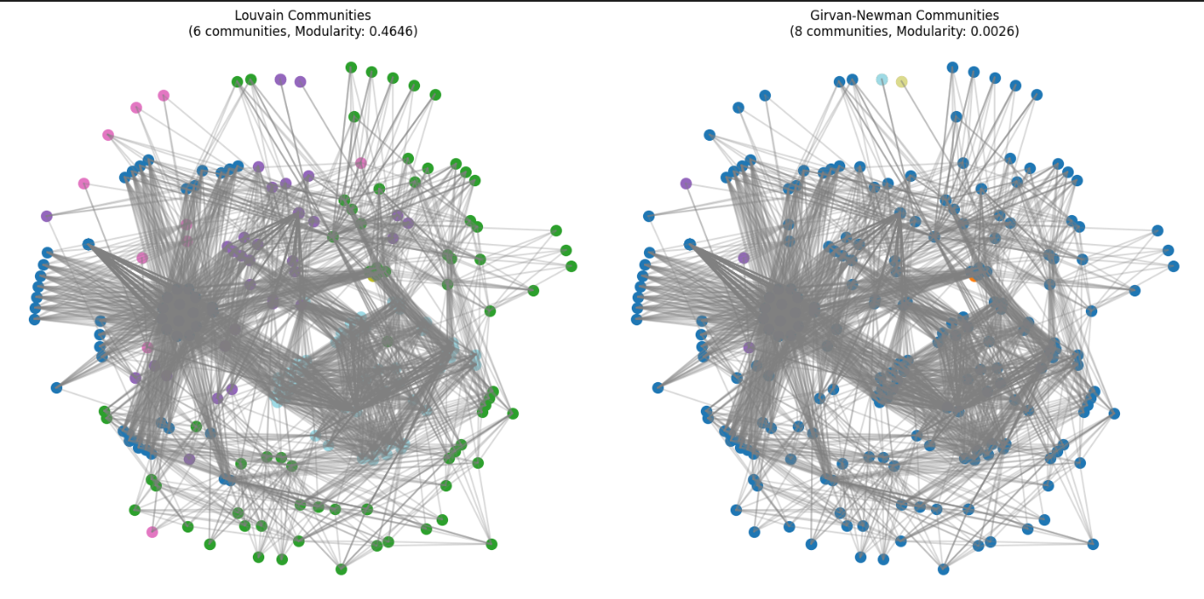
Community Visualization Comparison
I created a 2D visualization of the community structure of the country graph using Louvain and Girvan–Newman Algorithms (i had to convert it into an undirected graph)
Key Insight: We can clearly see that Louvain’s clusters are more balanced and interpretable, while Girvan–Newman’s result is fragmented—this suggests that the Louvain method is better suited for the Atlas network.

Slide 15
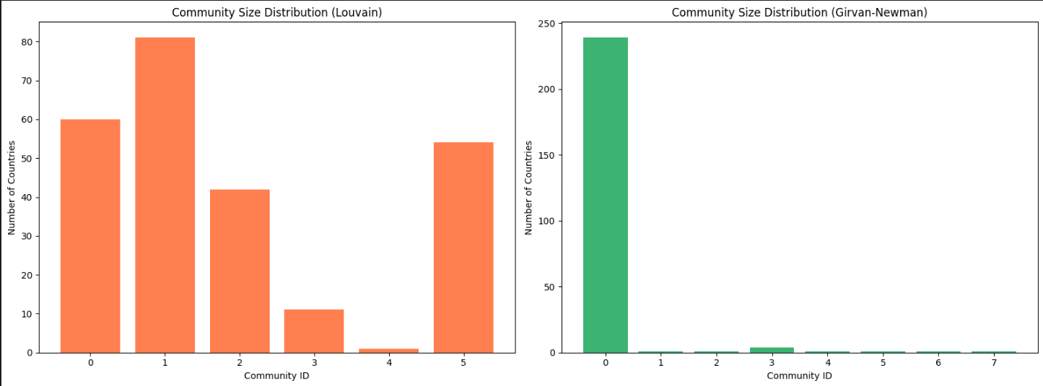
Analysis of Community Composition
I mapped each country to its continent using ISO country codes and then analyzed the composition of each community.
Findings with Louvain:
For example, Community 0 (60 nodes) has a mix of African (AF), Asian (AS), Oceanic (OC), and other countries, while Community 1 (81 nodes) shows a different balance.
So the question was: do these communities align with real-world cultural or geographic groupings?
Hypothesis: I believe that the communities, though derived from the Atlas rule, partially reflect geopolitical groupings (e.g., countries from Africa and Asia tend to cluster together).
Observation: The composition by continent supports this idea, confirming that the network structure has external validity.

Slide 16
Semantic Clustering of Country Names
I got even more curious about community composition so I checked whether linguistic patterns in country names reflect in the network.
I grouped countries based on suffixes such as “-stan”, “-land”, and “-ia” (ignoring case).
Results:
I found 7 “-stan” countries, 11 “-land” countries, 34 “-ia” countries, and 197 countries falling in “others”.
Question:
Can these semantic clusters be correlated with the communities detected by Louvain?
Hypothesis:
If there is significant overlap, it would indicate that the Atlas rule taps into real linguistic or cultural divisions.
Insight:
Even if not perfectly aligned, this analysis gives me a slight idea that the connectivity in the network has cultural and linguistic underpinnings.

Slide 17
Bridge Node Analysis
Looking at the PyVis graph, I also got interested in how a bridge between communities affects the graph. So I computed betweenness centrality to find nodes that might act as bridges between communities.
Findings:
Although no nodes exceeded the chosen threshold of 0.05 for being “bridge nodes”, the top 10 nodes by betweenness include Yemen, Oman, Azerbaijan, and Afghanistan.
Question:
Can controlling these high‐betweenness nodes give a player a strategic advantage by forcing opponents into less connected areas?
Hypothesis:
I believe that these nodes, even with moderate betweenness values, are very important for inter‑community connectivity and could be key targets for an effective strategy in the Atlas game. (not tested using my simulation yet)
Discussion:
By focusing on these nodes, a player might direct game flow and potentially trap an opponent.

Slide 18
Perturbation Analysis and Robustness
To test the stability of the community structure, I performed a perturbation analysis by removing 50% (can be any %) of the edges from the network.
Results:
The original Louvain modularity was 0.4646, and after perturbation, it slightly increased to 0.4708.
Question:
What does the minimal change in modularity imply?
Hypothesis:
Since the modularity values are almost the same, it means that the community structure is robust. Meaning, the detected communities remain stable even when the network is significantly disturbed.
Discussion:
This robustness is a strong sign that the communities are meaningful and not artifacts of minor connectivity patterns. It also suggests that strategic decisions based on these communities are likely to be reliable.
One observation is that as the amount of edges being removed increased, the modularity also increased (makes sense based on intuition)

Slide 19
Community-Centric Strategies & Cultural/Economic Correlations
I also computed internal density for each community to measure how tightly connected the nodes are.
Key Finding:
Some communities have high internal densities, meaning that if I start my move within these clusters, I may have many safe options while limiting my opponent’s moves. I also analyzed cultural/economic correlations using city population data.
Observation: The average population per community can help identify urban hubs that might be strategically significant.
Question: How can these metrics help my game strategy?
Hypothesis:
Communities with high internal density and high average population might represent strategic “safe zones” or hubs.
Conversely, targeting bridge nodes that connect different communities could disrupt an opponent’s move options.
Discussion:
These insights provide a multi‑faceted strategy: starting in dense communities, controlling key bridge nodes, and exploiting linguistic patterns to trap opponents. (not tested yet in my simulation)

Slide 20
Bonus Task – Link Prediction in Atlas
Link Prediction using Node2vec and GNNs:
In this bonus task, I explored whether a neural network can predict if an edge exists between two countries in the Atlas game.
I used two approaches: one based on Node2vec and another using a Graph Neural Network (GNN) implemented using PyTorch Geometric.
I trained these models in an unsupervised manner, as my dataset does not provide explicit labels for edge existence.
This work extends the project by combining advanced network embedding techniques with deep learning for link prediction.

Slide 21
Performance of the Link Prediction Models
Performance Metrics and Results:
Node2vec Approach:
I masked 20% of the edges in the Atlas graph and generated 64‑dimensional node embeddings using Node2vec.
The ROC AUC for Node2vec-based link prediction was 0.92296, indicating that the model is highly effective at distinguishing between positive (existing) and negative (non‑existing) edges.
GNN Approach:
I built a simple two-layer Graph Convolutional Network (GCN) using PyTorch Geometric.
Over 200 epochs, the training loss steadily decreased, and the Test AUC improved from 0.8747 at epoch 20 to 0.9702 at later epochs (with minor fluctuations).
These AUC values suggest that the GNN-based approach can accurately predict link existence.
Key Takeaway: Both models demonstrate strong performance. The Node2vec approach achieves an AUC above 0.92, and the GNN model’s performance improves significantly with training and usually achieves the same if not a higher AUC.

Slide 22
Analysis and Intuition Behind Constructed Features
Feature Engineering for Link Prediction:
My Approach:
For the Node2vec model, I used the graph structure itself to generate node embeddings. No explicit node features were required since the embedding captures the connectivity pattern.
For the GNN model, I needed explicit node features. I chose this approach:
I created one‑hot encoded features for each node by encoding the first and last letters of the country name. This results in a 52‑dimensional feature vector (26 dimensions for the first letter and 26 for the last letter).
Rationale: The Atlas rule is based on letter transitions, so the first and last letters are naturally informative. Therefore, these capture essential linguistic properties that influence the edge formation in the Atlas graph.
Intuition:
I believe that even such simple features can be powerful because they directly relate to the game’s rule. I also want to try explore better features using NLP techniques to boost performance further.

Slide 23
Unsupervised Training Objective for the GNN Model
Objective:
Since my dataset does not have labels for link existence, I needed to train the GNN in an unsupervised manner.
Training Strategy:
I used a margin ranking loss. This loss function encourages the model to assign higher scores to positive edges (those that exist in the graph) than to negative edges (non‑existent edges sampled via negative sampling).
How It Works:
For each pair of nodes connected by an edge, the model computes a score using a dot product of their embeddings.
Negative samples are generated by randomly sampling non‑edges.
The loss function ensures that the score for a positive edge is at least a margin (set to 1.0) higher than that for a negative edge.
My loss decreased from around 0.28 at epoch 20 to about 0.055 at epoch 200.
Expected Outcome:
Over time, the model learns to differentiate positive from negative edges, evidenced by a rising Test AUC (up to ~0.97 by epoch 200).

Slide 24
Summary and Insights from the Bonus Task
Key Points:
Both the Node2vec and GNN approaches achieved high ROC AUC scores, indicating strong link prediction capabilities.
The GNN model’s performance improved steadily with training, showcasing the effectiveness of the unsupervised margin ranking loss.
The choice of simple one-hot features (first and last letters) was effective because they directly capture the linguistic patterns that drive the Atlas rule.
Strategic Implications:
High-performance link prediction demonstrates that the Atlas network has a predictable structure.
We can use this to predict future moves in the game, getting a competitive advantage.
I also want to explore more complex features and GNN architectures to further enhance prediction accuracy.

